Slide 1

Computational Models for Micro-level Social Network Analysis
Jie Tang
Tsinghua University, China

Slide 2
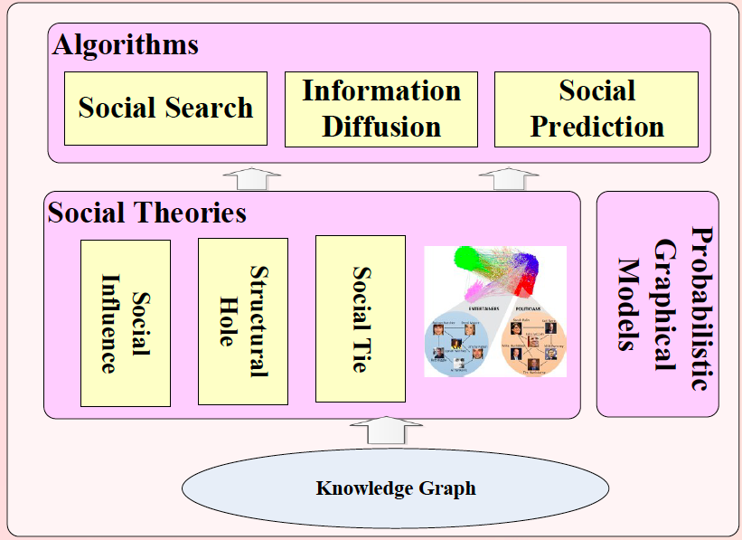
What we do: a big picture

Slide 3
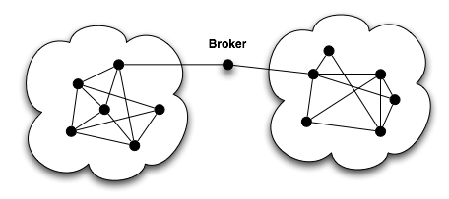
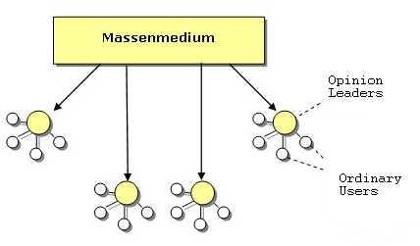
Computational Models for Micro-level Social Network Analysis
Social status theory
Two-step flow theory
Social theories
Social balance theory
Structural hole theory
Graphical models

Slide 4
Related Publications
SIGKDD (10)
WWW
ACM Multimedia
PLOS ONE (2)
PKDD’11 Best Stu Paper Runnerup
SIGKDD Best Poster Award
Multimedia’12 Challenge 2nd
Social Network
Data Mining
Knowledge Graph
Published more than 100 papers on major conferences and journals
IEEE/ACM Trans (12),
SIGIR (2)
IJCAI (3)
ACL (2)
ICDM (10)
JCDL’11 Best Paper Nominated
ICDM’12 Challenge Champion
SIGMOD
WWW
IJCAI (2)
IEEE TKDE
Journal of Web Semantics

Slide 5
What we do: a big picture

Slide 6
20+ Datasets
Network | #Nodes | #Edges | Behavior
Twitter-net | 111,000 | 450,000 | Follow
Weibo-Retweet | 1,700,000 | 400,000,000 | Retweet
Slashdot | 93,133 | 964,562 | Friend/Foe
Mobile (THU) | 229 | 29,136 | Happy/Unhappy
Gowalla | 196,591 | 950,327 | Check-in
ArnetMiner | 1,300,000 | 23,003,231 | Publish on a topic
Flickr | 1,991,509 | 208,118,719 | Join a group
PatentMiner | 4,000,000 | 32,000,000 | Patent on a topic
Citation | 1,572,277 | 2,084,019 | Cite a paper
Twitter-content | 7,521 | 304,275 | Tweet “Haiti Earthquake”
Most of the data sets are publicly available for research.

Slide 7
Micro-level Social Network Analysis
Comp. Models
Social Influence
Social Tie
Structural Hole
1
2
3

Slide 8
Micro-level Social Network Analysis
Comp. Models
Social Influence
Social Tie
Structural Hole
1
2
3

Slide 9
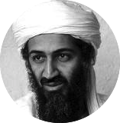


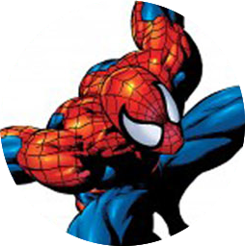


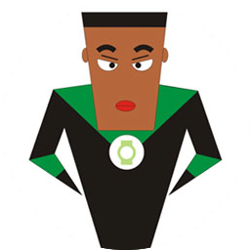
“Love Obama”
I love Obama
I hate Obama, the worst president ever
Obama is fantastic
Obama is great!
No Obama in 2012!
He cannot be the next president!
Positive
Negative
Notes:
Obama has done just that. From social networking to his blog to his Fight the Smears campaign, Obama has made his Web 2.0 presence known. He has over 1.5 million friends on MySpace and Facebook, and he currently has over 28,000,000 followers on Twitter. This personal activity in social networks allows him to quickly get the word out across multiple platforms.

Slide 10
Social Influence Analysis
Influence analysis
Topic-based influence measure [Tang-Sun-Wang-Yang 2009]
Learning influence distribution [Liu-Tang-Han-Yang 2010&2012]
Conformity influence [Tang-Wu-Sun 2013]
Social influence and behavior prediction
Social action tracking [Tan-Tang-Sun-Lin-Wang 2010]
User-level sentiment in social networks [Tan-et-al 2011]
Emotion prediction in mobile network [Tang-et-al 2012, spotlight paper]
Inferring affects from images [Jia-et-al 2012, Grand Challenge 2nd Prize]

Slide 11
Topic-based Social Influence Analysis
Social network -> Topical influence network
[1] J. Tang, J. Sun, C. Wang, and Z. Yang. Social Influence Analysis in Large-scale Networks. In KDD’09, pages 807-816.

Slide 12
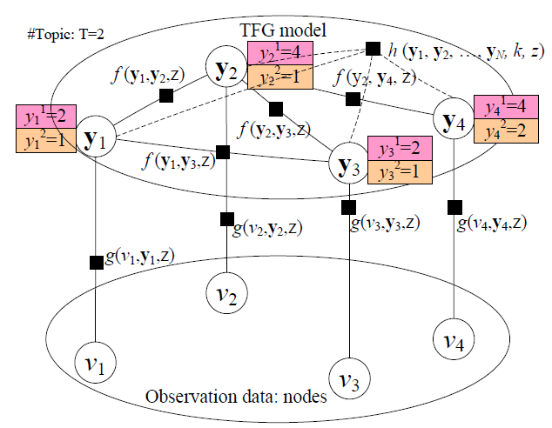
Topic-based Social Influence Analysis
Global constraint
Social link
Nodes that have the highest influence on the current node
Node/user
The problem is cast as identifying which node has the highest probability to influence another node on a specific topic along with the edge.
[1] J. Tang, J. Sun, C. Wang, and Z. Yang. Social Influence Analysis in Large-scale Networks. In KDD’09, pages 807-816.

Slide 13
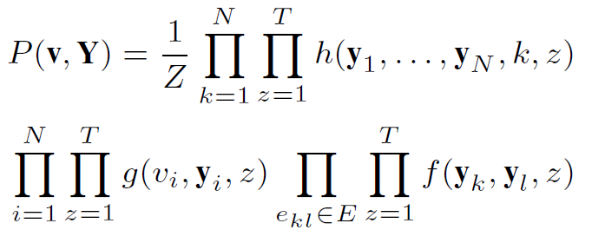
Topical Factor Graph (TFG)
The learning task is to find a configuration for all {y_{i}} to maximize the joint probability.
Objective function:
1. Feature Functions
Notes:
目标函数P描述了隐变量y_i取任意一组值时的联合概率分布

Slide 14
Probabilistic Generative Model
Influencing users
Influenced users
User
x
x
x
s=0
s=1
user interest
distribution
x
s
y
politics
z
selected topic
z
movie
z
z
word
w
Obama
w
w
avatar
w
[1] L. Liu, J. Tang, J. Han, and S. Yang. Learning Influence from Heterogeneous Social Networks. In DMKD, 2012, Volume 25, Issue 3, pages 511-544.

Slide 15
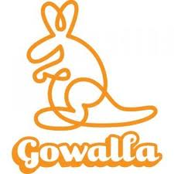
Confluence: Conformity Influence
Legend
Alice
Alice’s friend
Other users
1’
1’
1’
1’
Will Alice also check in nearby?
If Alice’s friends check in this location at time t
[1] J. Tang, S. Wu, and J. Sun. Confluence: Conformity Influence in Large Social Networks. In KDD’13, pages 347-355.

Slide 16
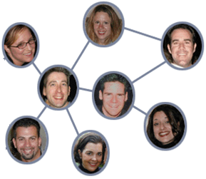
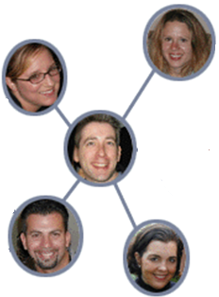
Social Influence & Action Modeling^{[1]}
Action Prediction：
Will John post a tweet on “Haiti Earthquake”?
Influence
1
Correlation
Time t+1
3
Time t
John
John
Action bias
4
Personal attributes:
Always watch news
Enjoy sports
….
Dependence
2
[1] C. Tan, J. Tang, J. Sun, Q. Lin, and F. Wang. Social action tracking via noise tolerant time-varying factor graphs. In KDD’10, pages 807–816.
Notes:
To predict users’ actions, we need to consider complex factors. What information we have, we have a dynamic social network, and also attributes of his own. Intuitively, what factors we need to consider? First, the influence from his friends, second, he will keep the same action or attitude as himself, we call it dependence. Third, correlation between neighbours. Finally, personal interests.

Slide 17
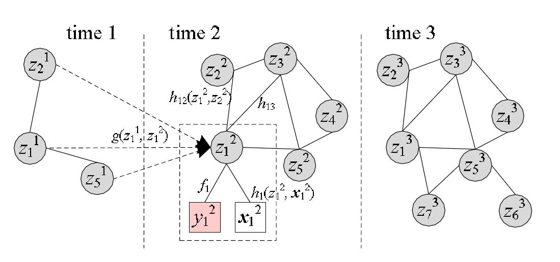
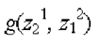
A Discriminative Model: NTT-FGM
Influence
Correlation
Personal attributes
Dependence
Continuous latent action state
Action
Personal attributes
Notes:
The model we propose is as the graph shows. This graph shows a three-stage social network. We first add a continuous latent state for each user’s action state. And the factors are all defined according to the latent state. First we user action bias factor to consider the noise in users’ actions. And the influence factor denotes the influence from the past. Finally correlation factor defines the correlation between users and also personal interests. For the action bias factor, we have two option to choose for binary actions: bernoulli and Gaussian. Gaussian can be extended to continuous actions. So we choose Gaussian in our model for potential extension.

Slide 18
User-level Sentiment Analysis
I love Obama
I hate Obama, the worst president ever
Obama is fantastic
Obama is great!
No Obama in 2012!
He cannot be the next president!
Positive
Negative
[1] C. Tan, L. Lee, J. Tang, L. Jiang, M. Zhou, and P. Li. User-level sentiment analysis incorporating social networks. In KDD’11, pages 1397–1405.
Notes:
Obama has done just that. From social networking to his blog to his Fight the Smears campaign, Obama has made his Web 2.0 presence known. He has over 1.5 million friends on MySpace and Facebook, and he currently has over 28,000,000 followers on Twitter. This personal activity in social networks allows him to quickly get the word out across multiple platforms.

Slide 19
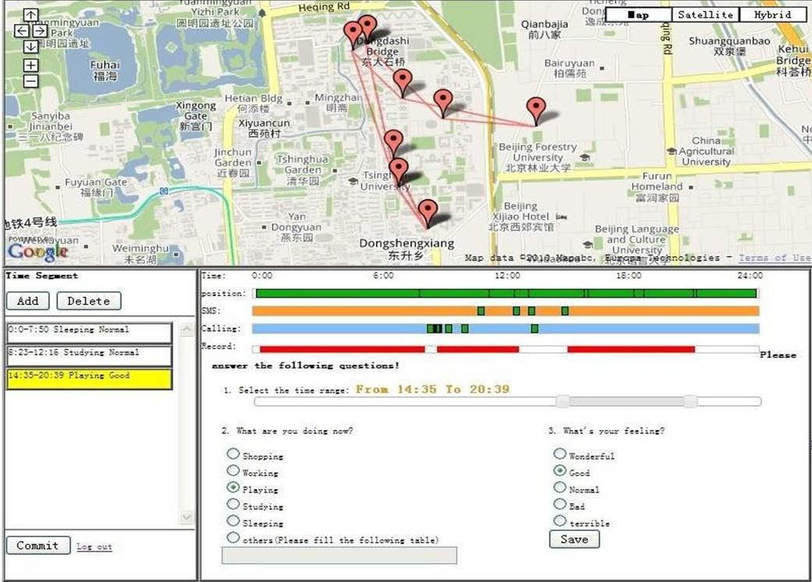
Happy System—case study
SMS & Calling
Location
Activities
Emotion
Can we predict users’ emotion?
[1] J. Tang, Y. Zhang, J. Sun, J. Rao, W. Yu, Y. Chen, and ACM Fong. Quantitative Study of Individual Emotional States in Social Networks. IEEE TAC, 2012, Volume 3, Issue 2, Pages 132-144. (Spotlight Paper)

Slide 20
Micro-level Social Network Analysis
Comp. Models
Social Influence
Social Tie
Structural Hole
1
2
3

Slide 21



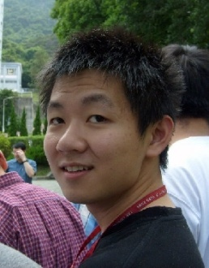
Family
?
Inferring social ties
Friend
?
Reciprocity
You
Lady Gaga
You
Lady Gaga
Triadic Closure
You
You
?
Lady Gaga
Shiteng
Lady Gaga
Shiteng
KDD 2010, PKDD 2011 (Best Paper Runnerup), WSDM 2012, ACM TKDD

Slide 22
Social Tie Analysis
Social relationship
Mining advisor-advisee relationships [Wang-Han-et-al 2010]
Learning to infer social tie [Tang-Zhuang-Tang 2011, Best Runnerup]
Reciprocity prediction [Hopcroft-Lou-Tang 2011]
Inferring social tie across networks [Tang-Lou-Kleinberg 2012]
Triadic closure
Inferring triadic closure [Lou-Tang-Hopcroft-Fang-Ding 2013]
Community
Kernel community [Wang-Lou-Tang-Hopcroft 2011]
Community co-evolution [Sun-Tang-Han-Chen-Gupta 2013]

Slide 23
Basic Idea
V₁
V₃
V₂
?
Friend
?
User→Node
?
?
r₂₄
r₅₆
Other
r₄₅
Relationship→Node
[1] C. Wang, J. Han, Y. Jia, J. Tang, D. Zhang, Y. Yu, and J. Guo. Mining Advisor-Advisee Relationships from Research Publication Networks. In KDD'10. pp. 203-212.
Notes:
Now, let’s discuss about the solutions. In general, there are two ways to model the problem. The first way is to model each user as a node [Click]. And another way is to model each relationship as a node [Click]
The first way is more intuitive, but it’s difficult to model the some correlations between different relationships. We use the second model.

Slide 24
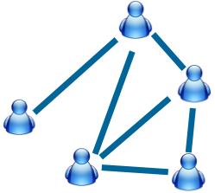
Partially Labeled Pairwise Factor Graph Model (PLP-FGM)
Constraint factor h
y₂₁=Friend
Partially Labeled
Model
y₁₂=Friend
Latent Variable
y₁₆=Other
Correlation factor g
Problem:
For each relationship, identify which type
has the highest probability?
Attribute factors f
Input
Model
Map relationship to nodes in model
Example: A makes call to B immediately after the call to C.
Example: Call frequency between two users?
[1] W. Tang, H. Zhuang, and J. Tang. Learning to Infer Social Ties in Large Networks. In ECML/PKDD'2011. pp. 381-397. (Best Student Paper Runner-up)
Notes:
Now we introduce our partially labeled pairwise factor graph model in detail. Take the mobile network as example. The left side is input mobile social network. [Click] And the right side is the formulized model. [Click] Each relationship in the input network is mapped to a relationship node in the model. [click]
For each relationship node, we have a corresponding latent variable y. [click] The value of latent variable indicates the type of relationship.
In this model, we define three different factors.
The first factor is attribute factor. For each relationship, there may exist some user-specific/link-specific attributes which can reflect the relationship type.
For example:
How frequently two users make call to each other?
These features are added in to the model as "attribute factors.“
The second factor is correlation factor. Different relationships may have some correlations. Let's image such a situation, user Bob makes call to Alice immediately after the call to Carl. Then, the relationship between Bob and Alice, and the relationship between Bob and Carl, are very likely to be the same.
[Click]
The third factor is constraint factor. There also may exist some common knowledge that can help us to infer the relationship types.
[Click]
Finally, this model is a partially labeled model. Some of the nodes are labeled and some are not.
[Click]
Based on this model, The problem is cast as, for each relationship, identify which type has the highest probability.

Slide 25
Inferring Social Ties Across Networks
Epinions
Mobile
What is the knowledge to transfer?
[1] J. Tang, T. Lou, and J. Kleinberg. Inferring Social Ties across Heterogeneous Networks. In WSDM'2012. pp. 743-752.

Slide 26
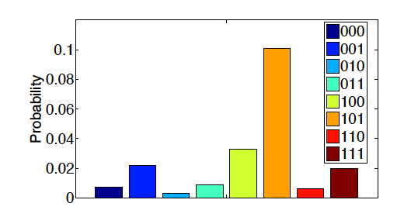
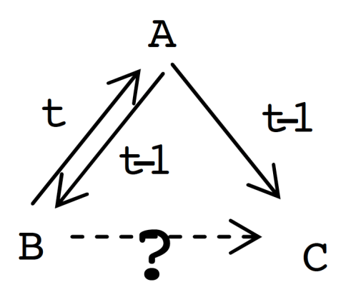
Triad Closure
Elite User(1)
Ordinary User(0)
Elite User(1)
(101)
P(1XX) > P(0XX). Elites users play a more important role to form the triadic closure. The average probability of 1XX is three times higher than that of 0XX.
P(X0X) > P(X1X). Low-status users act as a bridge to connect users so as to form a closure triad. The likelihood of X0X is 2.8 times higher than X1X.
P(XX1) > P(XX0). The rich gets richer. This phenomenon validates the mechanism of preferential attachment [Newman 2001].
[1] T. Lou, J. Tang, J. Hopcroft, Z. Fang, X. Ding. Learning to Predict Reciprocity and Triadic Closure in Social Networks. ACM TKDD.

Slide 27
Following Influence in Triad Formation
Two Categories of Following Influences
Whether influence exists?
A
A
t
t
B
C
B
t’=t+1
C
t’=t+1
Follower diffusion
Followee diffusion
–>: pre-existed relationships
–>: a new relationship added at t
-->: a possible relationship added at t+1

Slide 28
24 Triads in Following Influence
Follower diffusion
Followee diffusion
A
A
A
A
A
A
t
t
t
t
t
t
B
C
B
C
B
C
B
C
B
t'
C
B
t'
C
t'
t'
t'
t'
A
A
A
A
A
A
t
t
t
t
t
t
B
t'
C
B
C
B
t'
C
B
t'
C
B
C
B
t'
C
t'
t'
A
A
A
A
A
A
t
t
t
t
t
t
B
C
B
t'
C
B
t'
C
B
C
B
t'
C
B
t'
C
t'
t'
A
A
A
A
A
A
t
t
t
t
t
t
B
C
B
C
B
C
B
t'
C
B
C
B
t'
C
t'
t'
t'
t'
12 triads
12 triads

Slide 29
Micro-level Social Network Analysis
Comp. Models
Social Influence
Social Tie
Structural Hole
1
2
3

Slide 30
Structural Hole and Information Diffusion
Structural Hole
Mining Top-k structural hole spanners [Lou-Tang 2013]
Influence diffusion
Influence locality in information diffusion [Zhang-et-al 2013]

Slide 31
Mining Structural Hole Spanners
The theory of Structural Hole [Burt92]:
“Holes” exists between communities that are otherwise disconnected.
Structural hole spanners
Individuals would benefit from filling the “holes”.
Community 2
Community 1
On Twitter, Top 1% twitter users control 25% retweeting flow between communities.
Information diffusion
Community 3
[1] T. Lou and J. Tang. Mining Structural Hole Spanners Through Information Diffusion in Social Networks. In WWW'13, pages 837-848.
Notes:
What is structural hole? Structural hole first introduced by Burt in 1992, which states that.
“Holes” exists between communities.
Please look at the picture, this is a social network consists of 3 communities. There are only a few connections between communities, this phenonen is also called structural holes.
What is structural hole spanner? They are the users who filling the “holes”. For example, a0 and a5 act as a bridge position between communities, they’re likely to be viewed as structural hole spanners.
One important property for spanners is that, they are richer in information.
We discover an interesting phenomena on the twitter network. 1 - 25.
There’re many previous works proof the existance of structural holes. For example, in 2008, Kleinberg use games to model the dynamic of structural holes.
What we want to do is : the reverse process of previous works. Given the social network, how to detect structural hole spanners?

Slide 32
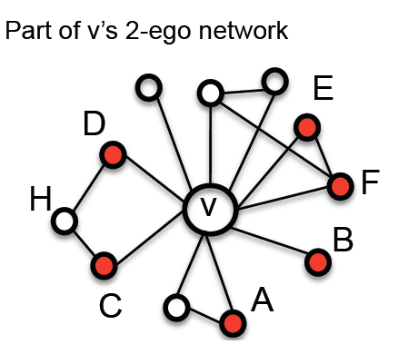
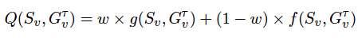
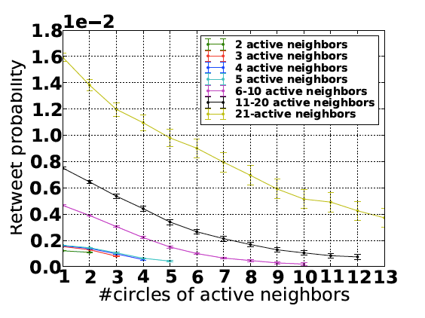
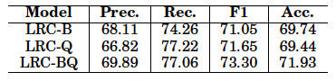
Influence Locality in Information Diffusion
Randomization test
Debiased testing
Locality influence indeed exist (t-test, p<<0.01)
Locality influence function
Help retweet prediction
The retweet probability is negatively correlated with the number of circles.
[1] J. Zhang, B. Liu, J. Tang, T. Chen, and J. Li. Social Influence Locality for Modeling Retweeting Behaviors. In IJCAI’13.

Slide 33
Micro-level Social Network Analysis
Topic-based influence
Learning influence
Conformity influence
Influence + Action
Comp. Models
Social Influence
Social Tie
Structural Hole
1
Inferring social ties
Reciprocity
Triadic closure
2
Structural hole spanner
Influence and retweeting
3

Slide 34
Other Data mining Work— Recommendation, Emotion Analysis, Expert Finding, Integrations, Content Analysis

Slide 35
Social Applications & Web Mining
Social recommendation
Cross-domain collaboration recommendation [Tang-et-al 2012, best poster]
Typicality-based recommendation [Cai-et-al 2013]
Patent partner recommendation [Wu-Sun-Tang 2013]
Expert finding
Topic level expertise search [Tang-Zhang-Jin-Yang-Cai-Zhang-Su 2011]
Expertise matching with constraints [Tang-Tang-Lei-Tan-Gao-Li 2012]
Combining topic model and random walk [Tang-Jin-Zhang 2008]
Expert finding in social networks [Zhang-Tang-Li 2007]
User profiling [Tang-Zhang-Yao 2007, Tang-Yao-Zhang-Zhang 2010]

Slide 36
Algorithms and Applications (cont.)
Information integration/alignment
Using Bayesian decision for alignment [Tang-et-al 2013]
Cross-lingual knowledge linking [Wang-Li-Wang-Tang 2012]
Cross-lingual knowledge linking via concept annotation [Wang-et-al 2013]
Name disambiguation [Tang-Fang-Wang-Zhang 2012]
A dynamic alignment framework [Li-Tang-Li-Luo 2009]
Unbalanced alignment [Zhong-Li-Xie-Tang-Zhou 2009]
Content analysis/text minining
Social content alignment [Hou-Li-Li-Qu-Guo-Hui-Tang 2013]
Social context summarization [Yang-et-al 2011]
Ontology learning from folksonomies [Tang-et-al 2012, spotlight paper]
Tree-structural CRF [Tang-et-al 2006]

Slide 37
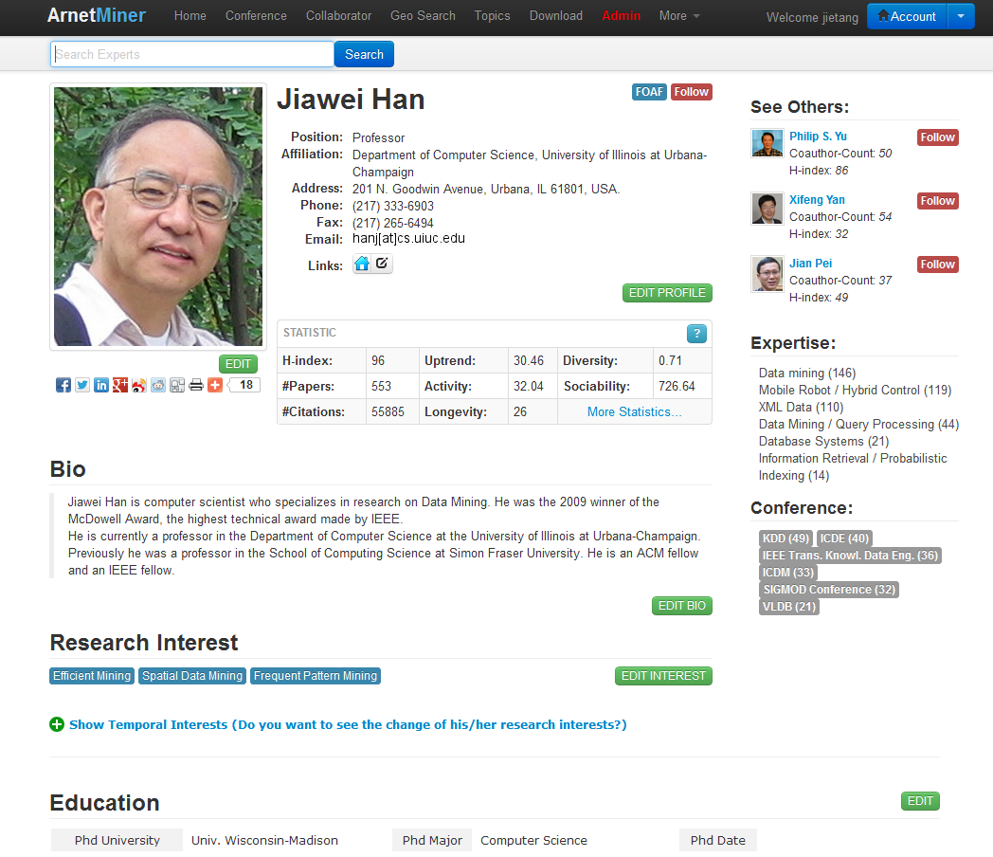
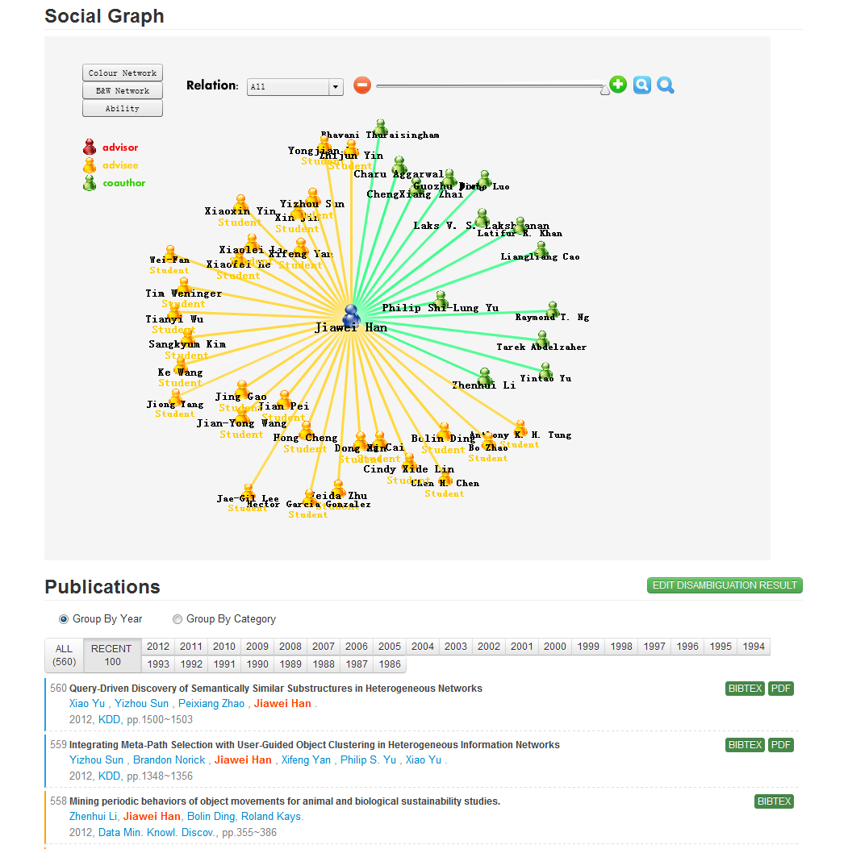
User Profiling
Basic Info.
Citation statistics
Social Network
Research Interests
Publications
[1] J. Tang, L. Yao, D. Zhang, and J. Zhang. A Combination Approach to Web User Profiling. ACM TKDD, (vol. 5 no. 1), 2010, 44 pages.

Slide 38
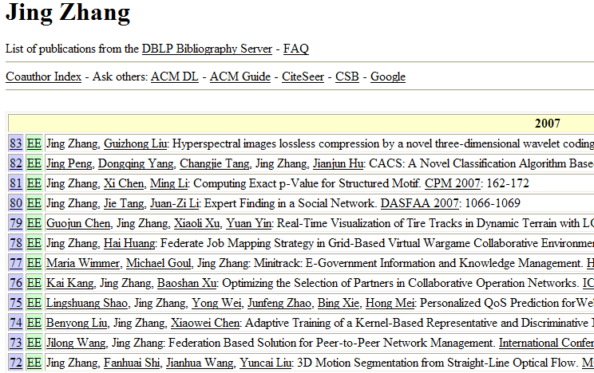
Name Disambiguation^{[1,2]}
Name | Affiliation
Jing Zhang (26) | Shanghai Jiao Tong Univ.
 | Yunnan Univ.
 | Tsinghua Univ.
 | Alabama Univ.
 | Univ. of California, Davis
 | Carnegie Mellon University
 | Henan Institute of Education
- How to perform the assignment automatically?
- How to estimate the person number?
[1] J. Tang, A.C.M. Fong, B. Wang, and J. Zhang. A Unified Probabilistic Framework for Name Disambiguation in Digital Library. IEEE Transaction on Knowledge and Data Engineering (TKDE) , Volume 24, Issue 6, 2012, Pages 975-987.
[2] X. Wang, J. Tang, H. Cheng, and P. S. Yu. ADANA: Active Name Disambiguation. ICDM’11, pages 794-803.

Slide 39
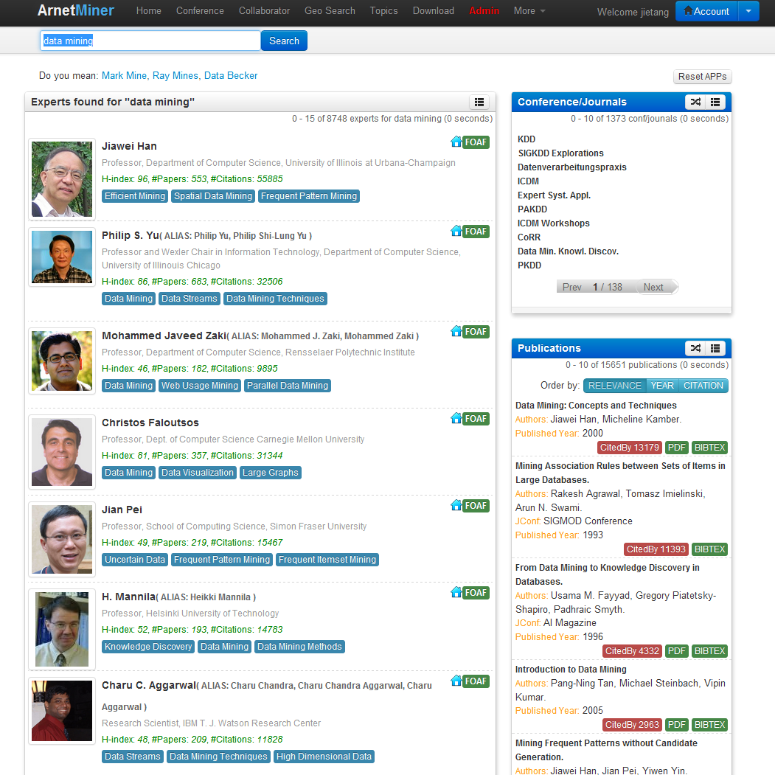
Expertise Search
Finding experts,
expertise conferences,
and expertise papers
for “data mining”
[1] J. Tang, J. Zhang, R. Jin, Z. Yang, K. Cai, L. Zhang, and Z. Su. Topic Level Expertise Search over Heterogeneous Networks. Machine Learning Journal, Volume 82, Issue 2 (2011), pages 211-237.

Slide 40
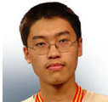


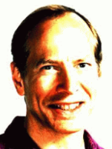
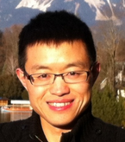
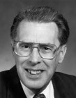
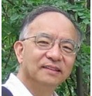
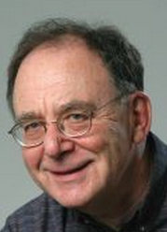


Cross-domain Collaboration Recommendation
Sparse Connection: <1%
Data Mining
1
Theory
Large graph
?
?
Automata theory
heterogeneous network
Complementary expertise
Graph theory
2
Sociall network
Complexity theory
Topic skewness: 9%
3
[1] J. Tang, S. Wu, J. Sun, and H. Su. Cross-domain Collaboration Recommendation. In KDD’12, pages 1285-1293. (Best Poster Award)
Notes:
Describe the problem
First, sparse connection, compared to traditional collaborations within a domain, cross-domain collaborations are very rare. partly because it is difficult for an outsider to find the right collaborator in the field that one does not know. This also makes it challenging to directly use a supervised learning approach due to the lack of training samples.
Second, complementary expertise, cross-domain collaborators often have different expertise and interest; For example, data mining researchers can easily identify who they want to work with in the data mining field, because they are familiar with the sub topics. However, for a cardiologist who wants to apply data mining techniques to predict heart failures, it will be difficult for her to find the right collaborators in data mining. Because these two fields (cardiology and data mining) are totally different with different terminology and problems. It is very difficult for one from cardiology to identify the right topics in data mining to look for collaborators.
Third, topic skewness, not all topics are relevant for crossdomain collaborations. In fact, in our study, only less than one-tenth of all possible topics pairs across domains have collaborations. Therefore, for the task of cross-domain collaboration recommendation, we should focus on better modeling those topics with high probability of having cross-domain collaborations

Slide 41
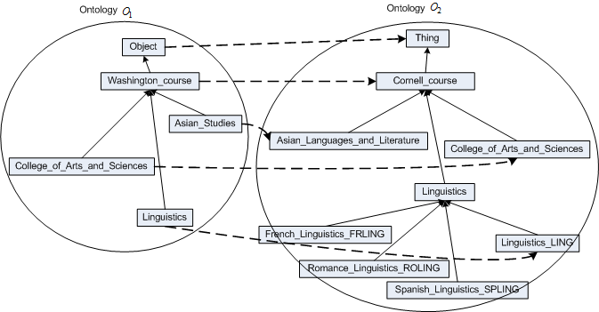
Schema Alignment
[1] Q. Zhong, H. Li, J. Li, G. Xie, J. Tang, and L. Zhou. A Gauss Function based Approach for Unbalanced Ontology Matching. SIGMOD’09, pages 669-680, 2009.
Notes:
Here, we use an example to explain what is schema matching.
The two schemas are defined respectively for courses of Washington university and Cornell university. The definition is organized into a hierarchy. The rectangle represents concept and the directed edge represents relation.
The task of ontology mapping is to find the corresponding relationships between the concepts of the two ontologies.
The red directed line represents the mapping from schema o1 to schema o2.

Slide 42
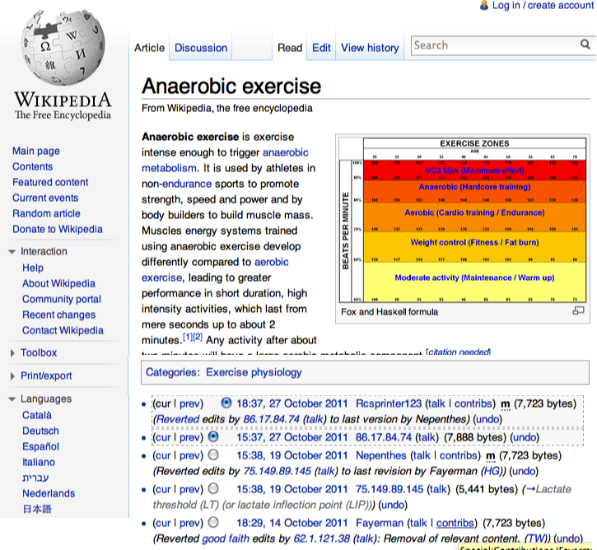
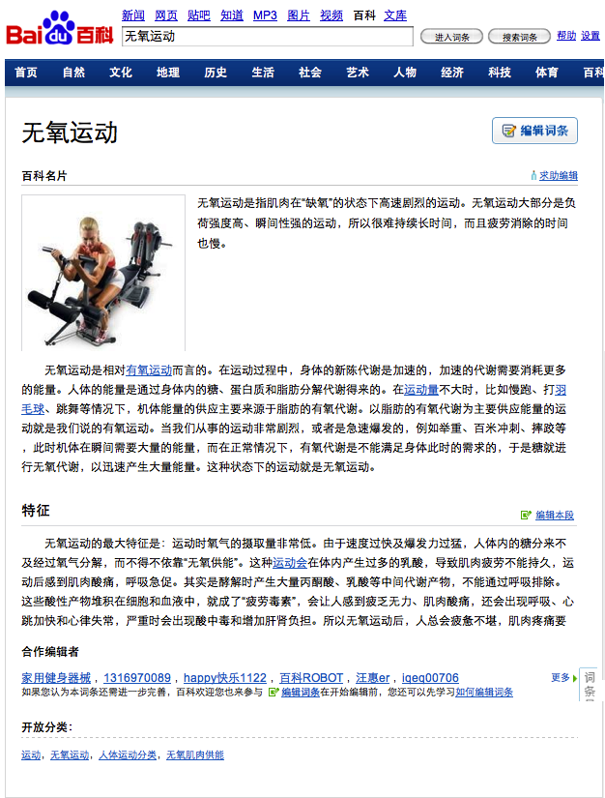
Knowledge Linking
Titles
Links
Categories
Cross lingual links
Authors
[1] Z. Wang, J. Li, Z. Wang, and J. Tang. Cross-lingual Knowledge Linking Across Wiki Knowledge Bases. In WWW'12, pages 459-468.
[2] Zhichun Wang, Juanzi Li, and Jie Tang. Boosting Cross-lingual Knowledge Linking via Concept Annotation. In IJCAI’13.
Notes:
Here is an example for a possible crosslingual link between Wikipedia and Baidu Baike. The left side is an English article “Anaerobic exercise” in Wikipedia, which describes a intense exercise used by athletes in non-endurance sports to promote strength, speed and power and by body builders to build muscle mass. In the left side bars, there are several crosslingual links link to German, Japanese equivalent articles, but without links to Chinese article. However, we can find the Chinese article “无氧运动” in Baidu. This is an example of manually finding equivalent articles between Wikipedia and Baidu, when we build an approach to automatically find these links, there will be several challenges.
anaerobic [,ænεə'rəubik]

Slide 43
Results
Discover crosslingual links between Wikipedia and Baidu
 | Articles | Categories | Authors
Wikipedia | 3,786,000 | 531,771 | 3,592,495
Baidu | 3,941,659 | 599,463 | 1,454,204
217,689
96,970
202,141

Slide 44
System

Slide 45
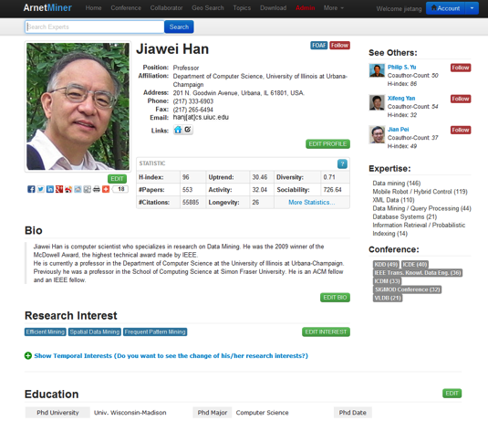
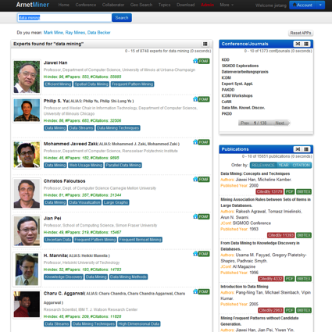
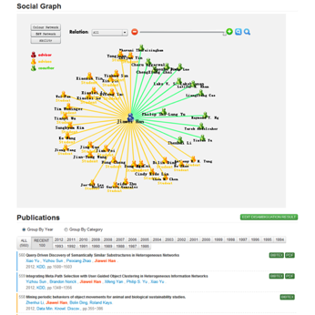
AMiner (ArnetMiner)^{[1]}
Academic Social Network Analysis and Mining system—Aminer (http://aminer.org)
Online since 2006
>1 million researcher profiles
>131 million requests
>2.35 Terabyte data
100K IP access from 170 countries / month
10% increase of visits per month
Key Features
Mining semantics from academic data
Deep social network analysis
Knowledge based search
[1] J. Tang, J. Zhang, L. Yao, J. Li, L. Zhang, and Z. Su. ArnetMiner: Extraction and Mining of Academic Social Networks. In KDD’08. pp.990-998.

Slide 46
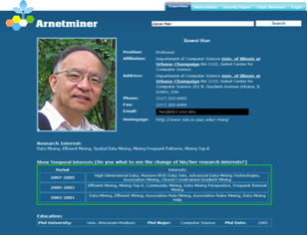
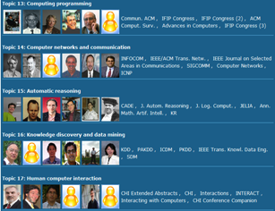
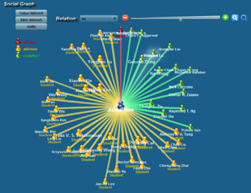
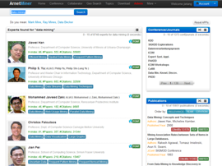
AMiner History
2006
2009
2010
2012
Research profiling
Integration
Interest analysis
Topic analysis
Course search
Expert search
520K users from 187 countries
Association
Disambiguation
Suggestion
1.02M users from 202 countries
Geo search
Collaboration recommendation
432M users from 220 countries

Slide 47
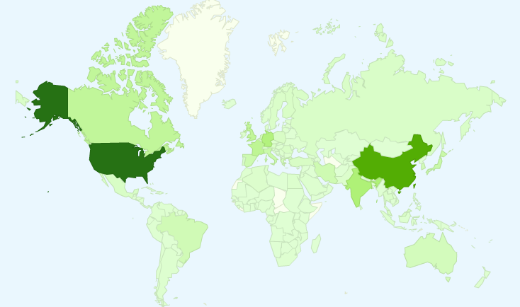
User Distribution
4.32 million IP from 220 countries/regions

Slide 48
User Distribution
4.32 million IP from 220 countries/regions
Top 10 countries
1. USA 6. Canada
2. China 7. Japan
3. Germany 8. Spain
4. India 9. France
5. UK 10. Italy
Notes:
截止目前，Arnetminer系统已有来自200个国家和地区277万独立IP的访问，这里列出了访问量前10的国家。

Slide 49
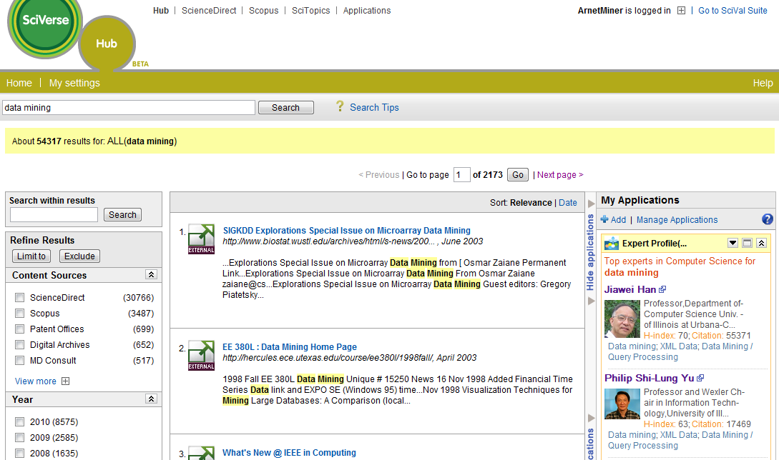
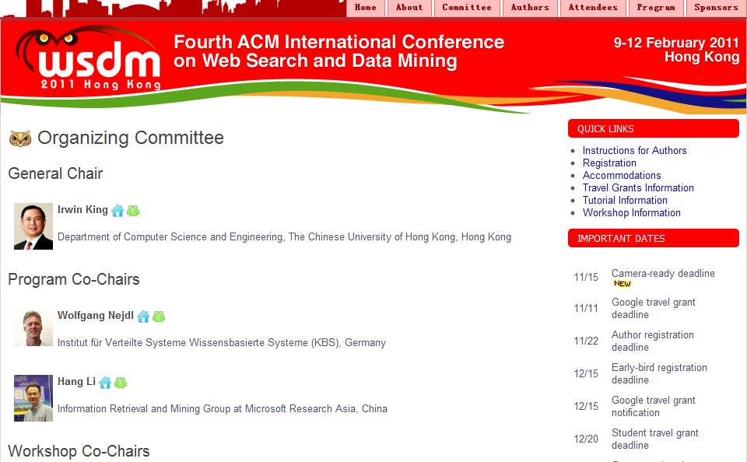
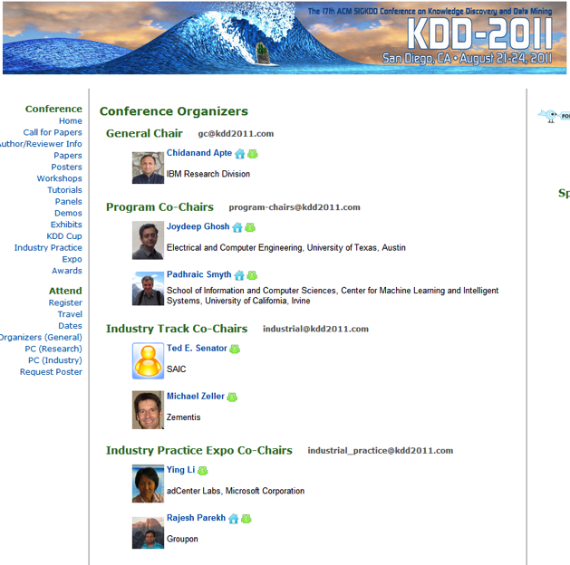
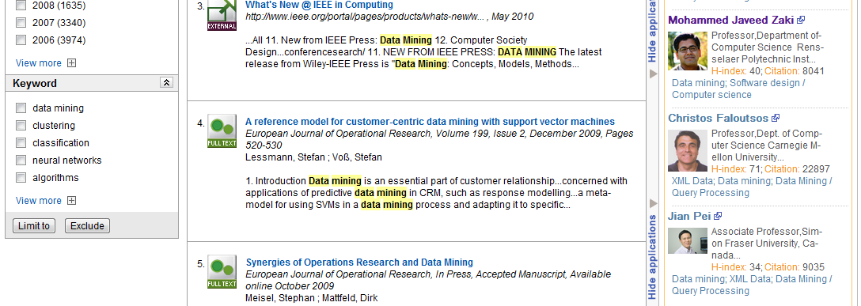
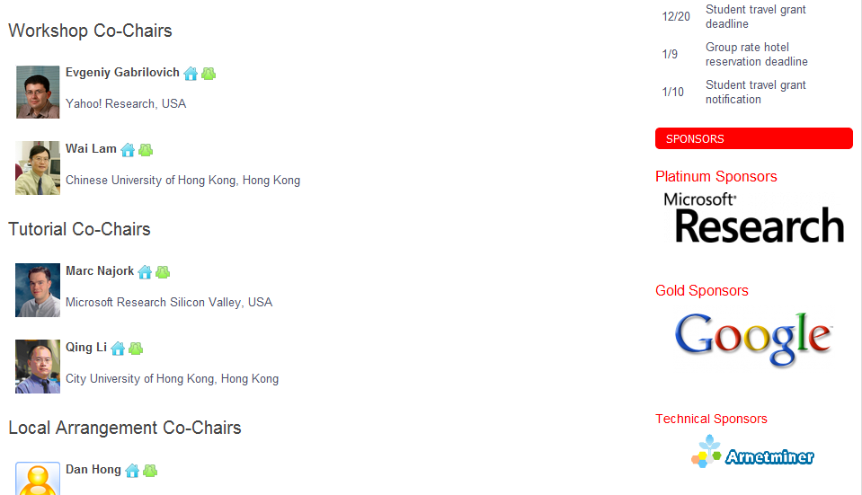
Widely used..
The largest publisher:
Elsevier
Conferences
KDD 2010
KDD 2011
KDD 2012
KDD 2013
WSDM 2011
ICDM 2011-13
SocInfo 2011
ICMLA 2011
WAIM 2011
etc.
……

Slide 50
AMiner Platform…
AMiner Platform
Mining drug discovery data
Predicting targets
Repurposing drugs
Heterogeneous graph search
SLAP
Mining more data…
Mining knowledge from patents:
Competitor analysis
Company search
Patent summarization
...
Mining knowledge from articles:
Researcher profiling
Expert search
Topic analysis
Reviewer suggestion
PatentMiner
ArnetMiner

Slide 51
PatentMiner: Topic-driven Patent Analysis and Mining
[1] J. Tang, B. Wang, Y. Yang, P. Hu, Y. Zhao, X. Yan, B. Gao, M. Huang, P. Xu, W. Li, and A. K. Usadi. PatentMiner: Topic-driven Patent Analysis and Mining. KDD'12. pp. 1366-1374.

Slide 52

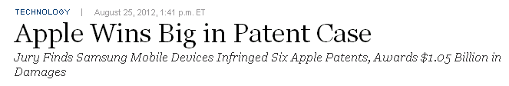
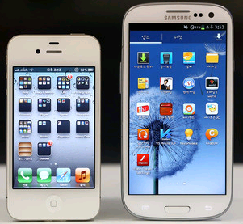
A court decision in 08/2012: Samsung’s Galaxy smart phone infringed upon a series of patents of Apple’s iphone, besides 4 appearance design patents, 3 software patents so-called 381, 915, and 163 are included, respectively cover "bounce back" , “pinch-to-zoom”, and “tap-to-zoom”.
The above 3 software patents all belong to the following three patent categories: active solid-state devices (touch screen), computer graphics processing (graph scaling), and selective visual display systems (tap to select).

Slide 53


Slide 54



Knowledge and Network Integration
A Uniform Patent Search and Analytic System
Hidden Topics
Patents
Competitive Network

Slide 55
Patent Search
Topics of search results
Top Patents
Top Inventors
Top Companies

Slide 56



Topic-based Analysis for “Microsoft”
Notes:
Also, for a specific company, the system analyzes its patent trend, that is, in a year like 2010, how many patents the company issued. Analysis results of hot terms trends, and top inventors trends also shows here [click]. Additionally, we mine the competitive relationships between companies in this work. For example, here is a list of Microsoft’s competitors generated by the system. We see that IBM and Apple are on the list. We also give a comparison between competitors. [40]

Slide 57
What is PMiner?^{[1]}
Current patent analysis systems focus on search
Google Patent, WikiPatent, FreePatentsOnline
PMiner is designed for an in-depth analysis of patent activity at the topic-level
Topic-driven modeling of patents
Heterogeneous network co-ranking
Intelligent competitive analysis
Patent summarization
* Patent data:
> 3.8M patents
> 2.4M inventors
> 400K companies
> 10M citation relationships
* Journal data:
> 2k journal papers
> 3.7k authors
The crawled data is increasing to >300 Gigabytes.

Slide 58




Opportunity: exploiting social network and data mining in the real-world
Web, relational data, ontological data, social data
Data Mining and Social Network techniques
Scientific
Literature
Users cover >180
countries
>600K researcher
>3M papers
Arnetminer.org
(NSFC, 863)
Social search
& mining
Social extraction
Social mining
IBM, Huawei
Advertisement
Advertisement
Recommendation
Sohu, Tencent
Mobile Context
Mobile search
& recommendation
Nokia, GM
Energy trend
analysis
Energy product
Evolution
Techniques
Trend
Oil Company
Large-scale
Mining
Scalable algorithms
for message tagging
and community
Discovery
Google, Baidu
Search, browsing, complex query, integration, collaboration, trustable analysis, decision support, intelligent services,

Slide 59







Future Directions
Modeling user lifecycle and structure changes
Building role-aware information diffusion models
Mining the fundamental difference between different networks

Slide 60
Related Publications
Tiancheng Lou and Jie Tang. Mining Structural Hole Spanners Through Information Diffusion in Social Networks. In WWW'13, pages 837-848, 2013.
Jing Zhang, Biao Liu, Jie Tang, Ting Chen, and Juanzi Li. Social Influence Locality for Modeling Retweeting Behaviors. In IJCAI'13.
Jie Tang, Sen Wu, and Jimeng Sun. Confluence: Conformity Influence in Large Social Networks. In KDD'2013.
Tiancheng Lou, Jie Tang, John Hopcroft, Zhanpeng Fang, Xiaowen Ding. Learning to Predict Reciprocity and Triadic Closure in Social Networks. In TKDD, 2013.
Jie Tang, Jimeng Sun, Chi Wang, and Zi Yang. Social Influence Analysis in Large-scale Networks. In KDD’09, pages 807-816, 2009.
Jie Tang, Jing Zhang, Limin Yao, Juanzi Li, Li Zhang, and Zhong Su. ArnetMiner: Extraction and Mining of Academic Social Networks. In KDD’08, pages 990-998, 2008.
Chenhao Tan, Jie Tang, Jimeng Sun, Quan Lin, and Fengjiao Wang. Social action tracking via noise tolerant time-varying factor graphs. In KDD’10, pages 807–816, 2010.
Chi Wang, Jiawei Han, Yuntao Jia, Jie Tang, Duo Zhang, Yintao Yu, and Jingyi Guo. Mining Advisor-Advisee Relationships from Research Publication Networks. In KDD'10, pages 203-212, 2010.
Chenhao Tan, Lillian Lee, Jie Tang, Long Jiang, Ming Zhou, and Ping Li. User-level sentiment analysis incorporating social networks. In KDD’11, pages 1397–1405, 2011.
Tiancheng Lou, Jie Tang, John Hopcroft, Zhanpeng Fang, Xiaowen Ding. Learning to Predict Reciprocity and Triadic Closure in Social Networks. In TKDD.
Lu Liu, Jie Tang, Jiawei Han, and Shiqiang Yang. Learning Influence from Heterogeneous Social Networks. In DMKD, 2012, Volume 25, Issue 3, pages 511-544.

Slide 61
Thanks to all of our collaborators!
John Hopcroft, Jon Kleinberg, Lillian Lee, Chenhao Tan (Cornell)
Jiawei Han, Chi Wang, Yizhou Sun, and Duo Zhang (UIUC)
Tiancheng Lou (Google)
Jimeng Sun (IBM)
Wei Chen, Ming Zhou, Long Jiang (Microsoft)
Jing Zhang, Zhanpeng Fang, Zi Yang, Sen Wu, Jia Jia (THU)
......
Jie Tang, KEG, Tsinghua U, http://keg.cs.tsinghua.edu.cn/jietang
Download all data & Codes, http://arnetminer.org/download

